Slide 1
Program Planning Templates
Having a Plan Everyone Can Follow

Slide 2
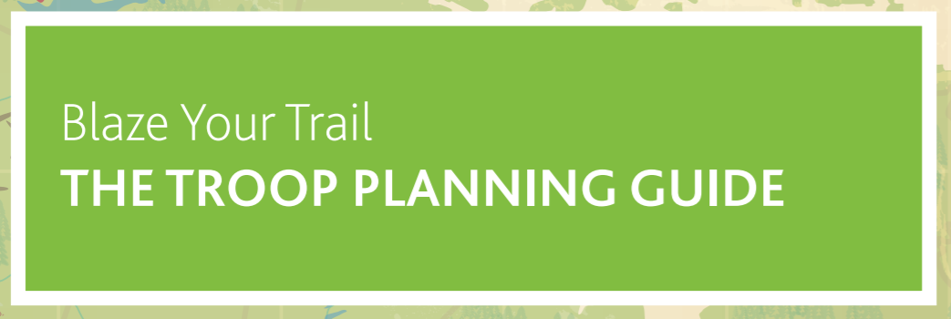
The Templates click the boxes for hyperlinks

Slide 3
What’s in Each Planning Guide?
Goal Suggestions
Big Ideas At-A-Glance Page
Useful questions to ask the youth in the Planning stage
Cycle at-a-glance pages
Month at-a-glance pages
Review questions for the end of Cycle
Places to record who is doing the Planning, Doing, and Reviewing
Spaces where the youth Leadership Team can contribute

Slide 4
Why Use It?
The Program Planning Template is used during the entire Scouting year and serves as a workbook that can be created and edited throughout he Scouting year.
It can be stored online in a Google Drive or on a Cloud, and can be brought to meetings in a binder for easy access by the youth.
Having a plan with names of those responsible beside activities and events allows everyone to know what their part is. Especially for youth.
It allows sections to better prepare for Fundraising needs and Group Committee meetings.

Slide 5
How this Benefits Youth
In order for people to be successful, they need to be prepared. In order to be prepared, there needs to be a plan. In order to have a plan, there needs to be discussion and decisions. In order to have discussions and decisions, there needs to be engaged youth and Scouters.
This template helps support all of these outcomes by using a layout that is easy to engage with, provides discussion prompts, requires decisions to be made, gives people an understanding of their part, and allows for everyone involved to feel confident.

Slide 6
Supporting the Program
Each section is going to receive a copy of the Program Planning Template in the second week of September to use during their program planning.
Melissa will be bringing them over from Vancouver on September 7 and will deliver them to Scout House into the Cubbies.

